Slide 1
USW-Flex-2.5G-5 (113-10458) ed35
V1.0.1
2024/07/01
CONFIDENTIAL - INTERNAL USE ONLY

Slide 2

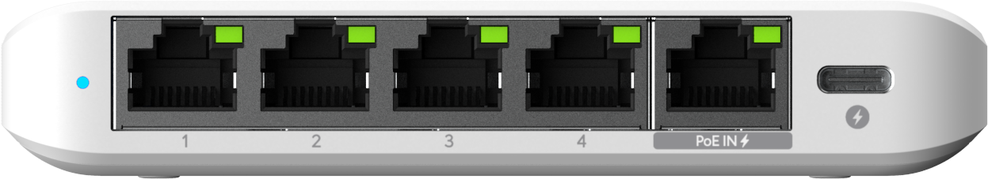
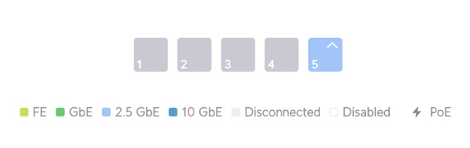
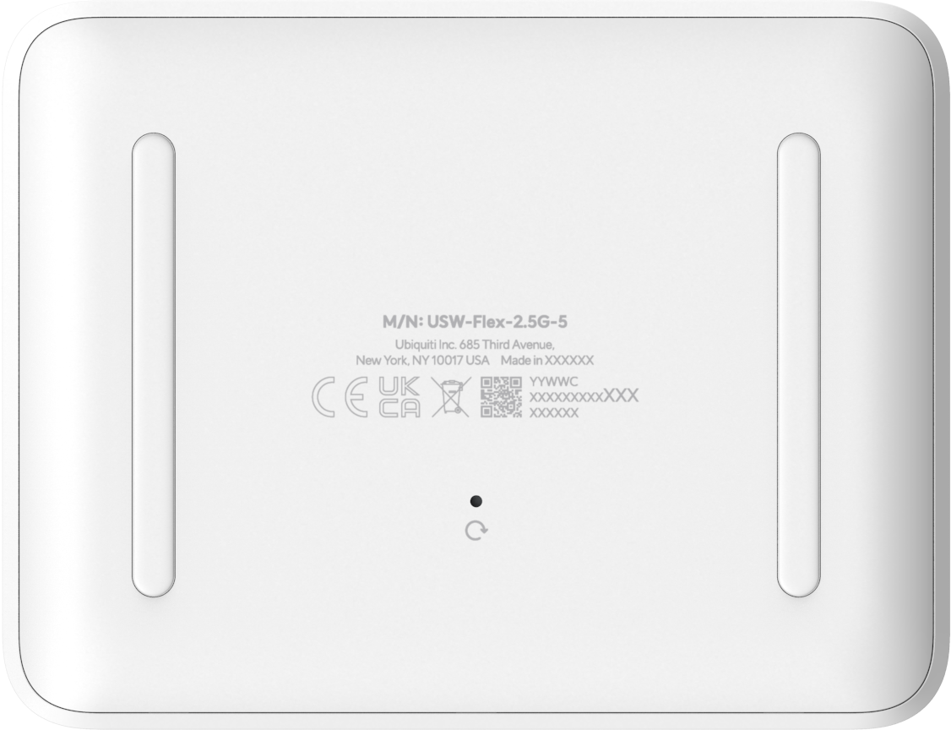
Product Overview
Top
Bottom

Slide 3
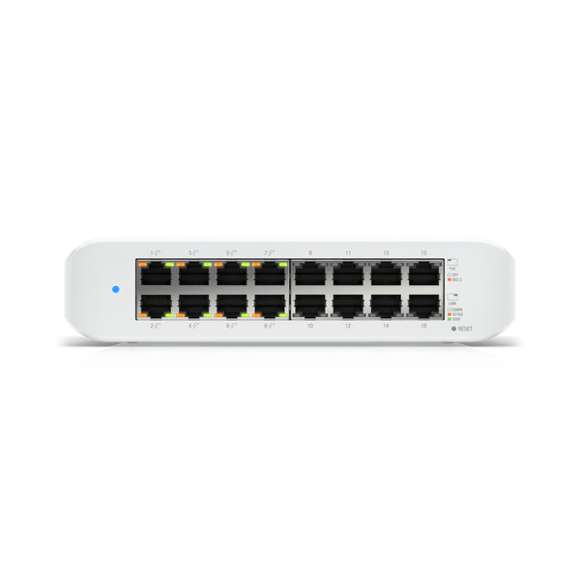
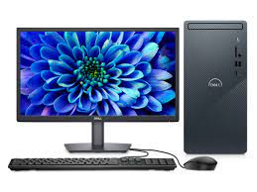
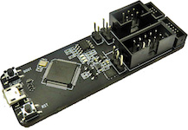
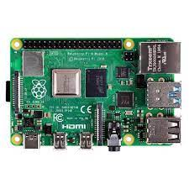

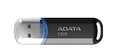
FCD_Environment
Ethernet Cable
Ethernet Cable
Switch(option)
Ethernet Cable
ESP32 Prog
DUT
PC
Console Cable
RPI4
Internet
USB Disk

Slide 4
FCD_Registration_USW-FLEX-2.5G-5
Step.
1.Input Passphrase Key and BOM rev
2.Check selected region is correct
3.Click submit
4.Scan MAC Label then click start
FCD version: FCD_USW_FLEX_2.5G-SERIES_1.0.1_1.3.1.tgz MAC Label format: MAC-QR-AC

Slide 5
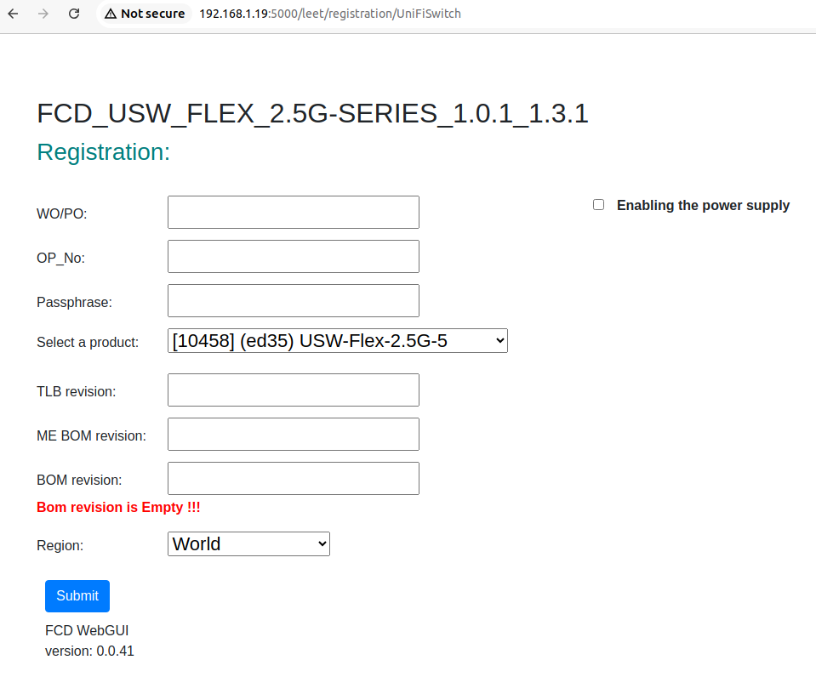
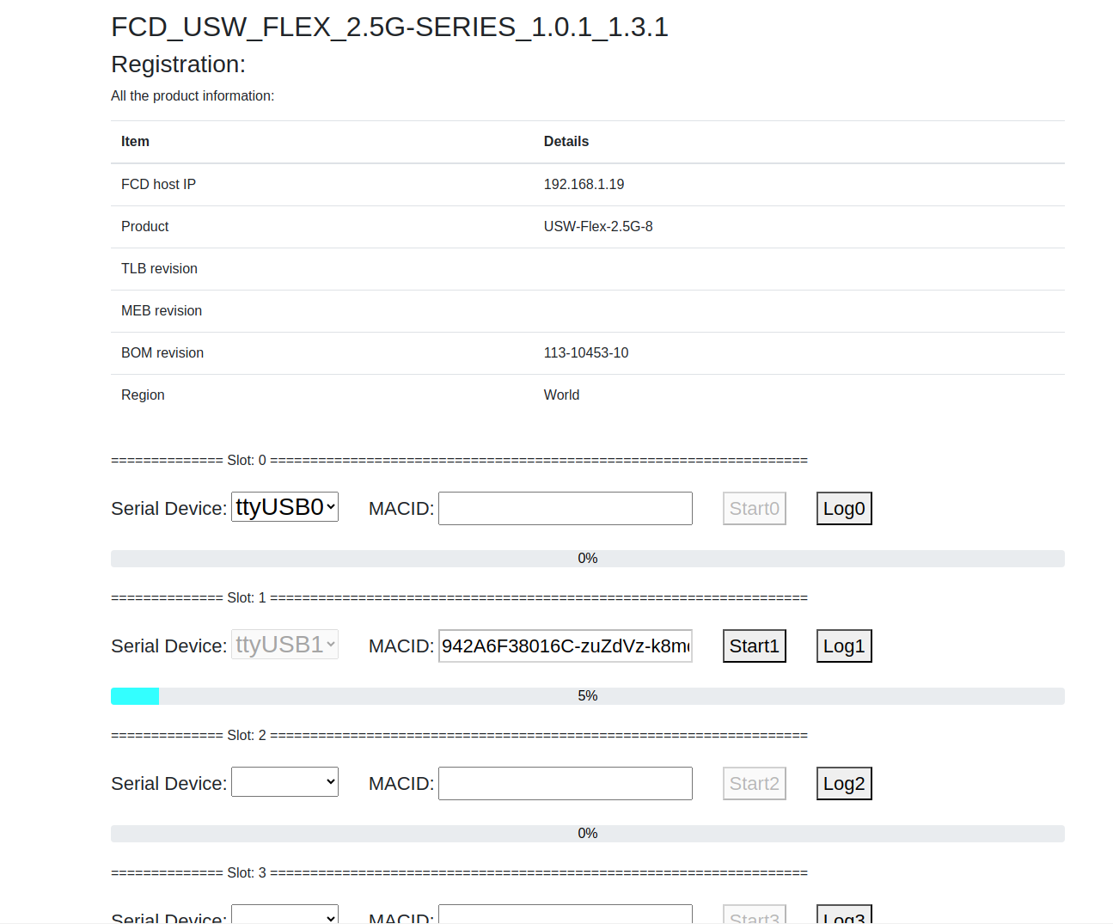
FCD Dashboard (Example)

Slide 6
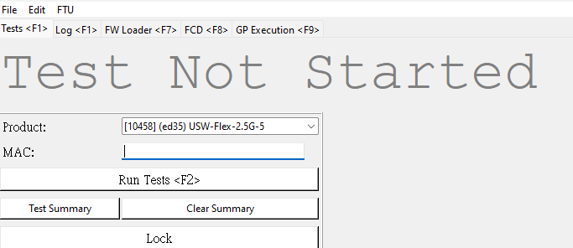
FTU Basic Setup
Step.
1.Connect ethernet cable to port 5
2.Click run_windows_mvc.bat open FTU
3.Select product “USW-Flex-2.5G-5”
4.Scan MAC Label
FTU version: MAC Label format: MAC-QR-AC

Slide 7

Basic Info Test
Step.
1.Check below test items are selected to validate basic information before functional testing
2. Check if all the criteria are met as expected before testing.

Slide 8
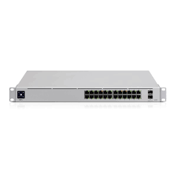

FTU_Environment
Internet
Ethernet Cable
Adapter
5V / 1A
DUT
USW-Pro-24-POE
PC
Port 5 of DUT

Slide 9

Reset Button Test
Step.
1.Check "Check reset button" item selected
2.Check if all the criteria are met as expected before testing.
3.Follow the notification prompt window then press reset button.

Slide 10

Enable Burn In Test
Step.
1.Check "Enable Burn in test” item selected.
2.Check Burn-In configuration
3.After finish Enable burn-in mode test item, burn-in mode will auto run in next boot up time.
Burn-In condition:45°C，4HR
Follow the setup instructions for connecting ports after enabled burnin mode and DUT is being powered off
Adapter
5V / 1A
DUT
P1
P2
P3
P4
P5
Using 2 PCS RJ45 cables to loop DUT port 2 -> port 3 , port 4 -> port 5

Slide 11
Check Burn in Result Test
Step.
1.Check "Check Burn in result” item selected.

Slide 12
Check Ethernet LED
Step.
1.Check "Check Port Link” item selected.
Using 2 PCS RJ45 cables to loop DUT port 1 -> port 2 , port 3 -> port 4
Adapter
5V / 1A
DUT
P1
P2
P3
P4
P5
PC Host

Slide 13
Check System LED
Step.
1.Check "Check System LED” item selected.

Slide 14
Nustream Test
Power
Step.
1.Check "Snake test” item selected.
Ethernet
Loopback
2.5G Data Line
Adapter
5V / 1A
DUT
P1
P2
P3
P4
P5
PC Host
2.5G
2.5G
2.5G
Packet Generator

Slide 15
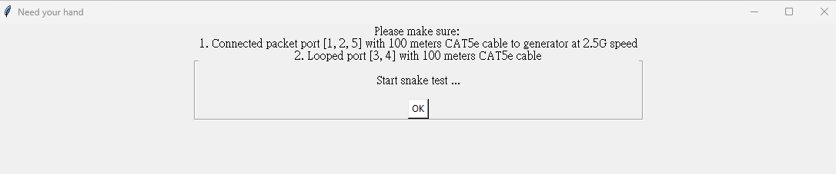

Nustream Test cont…
Start transmit packets from Nustream 900i
Check TX/RX packet counters

